Slide 2
Objectives
To identify plant structures and functions.
To describe the structure of plant cells.
To explain the process of reproduction in plants.

Slide 3
Main Menu
Plant Cell Biology
Plant Structures
Roots
Stems
Flowers
Leaves
Fruit
Seeds

Slide 5
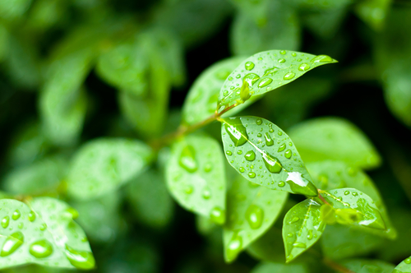
Plants
Plants
are multicellular organisms
are incapable of movement
produce food through photosynthesis

Slide 6
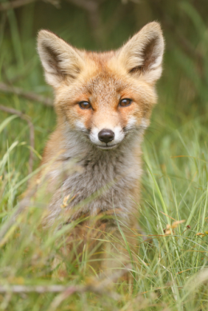
Animals
Animals
are multicellular organisms
are capable of movement, on their own
cannot produce their own “food”
Ingest food from
surroundings

Slide 7
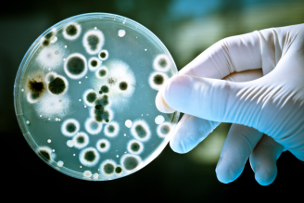
Cell Types
Include:
Prokaryotic
pro = before; karyon = nucleus
found in bacteria
do not contain a nuclei
lack membrane-bound organelles
Fun Fact: Since viruses are acellular – they contain no organelles and cannot grow and divide – they are considered neither prokaryotic or eukaryotic.

Slide 8
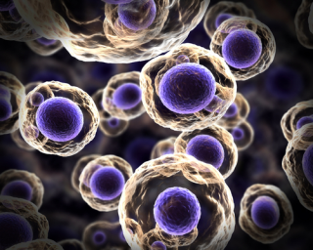
Cell Types
Include:
Eukaryotic
eu = good; karyon = nucleus
found in plants and animals
contain a nucleus
contain membrane-bound organelles

Slide 9
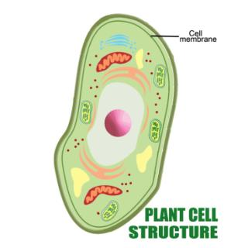
Cell Membrane
Surrounds the cell as a thin layer of protein (about eight-millionths of a millimeter thick)
Can be found inside the cell wall
Allows some substances to pass into the cell while blocking others

Slide 10
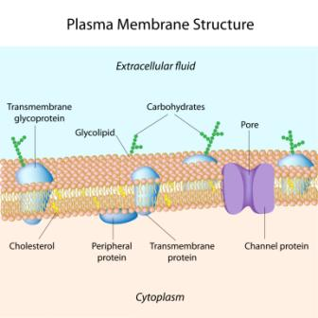
Cell Membrane
Is also known as the plasma membrane
Is involved in cellulose production for the assembly of cell walls
Is composed of highly
structured proteins
and phospho-lipids

Slide 11
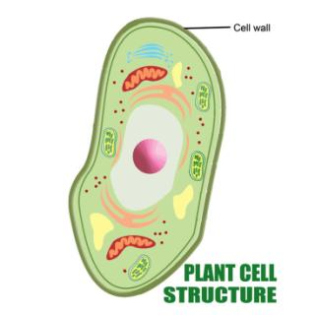
Cell Wall
Are found only in plants
Surrounds the cell
Provides structure and support
Bonds with other cell walls to create plant structure

Slide 12
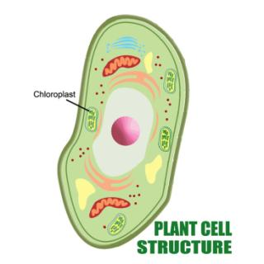
Chloroplast
Is an elongated organelle containing chlorophyll
Converts light and carbon dioxide to usable energy
Organelle: specialized part of a cell which has a specific function

Slide 13
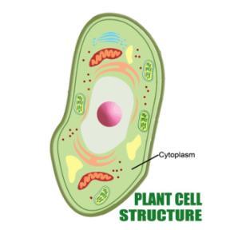
Cytoplasm
Is a gel-like material outside the nucleus,
but inside cell
membrane
Contains all other organelles
floating in cytoplasm
Fun Fact: substance of a living cell, including the cytoplasm and nucleus, is known as the protoplasm.

Slide 14
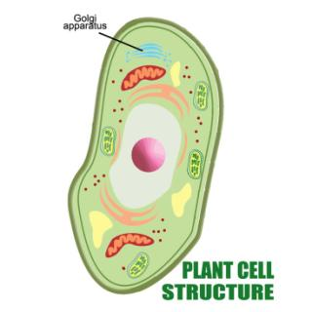
Golgi Apparatus
Is a flat, layered organelle (dictyosomes) which resembles a stack of pancakes
Is located near the nucleus
Packages proteins and carbohydrates for export from the cell
Modifies proteins and lipids before distributing them

Slide 15
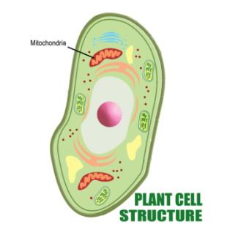
Mitochondria
Is the powerhouse of the cell
Are spherical, rod-shaped organelles
Have a double membrane
Converts energy stored in glucose to ATP for the cell (Respiration)
ATP: adenosine triphosphate, the molecule which provides the energy in the cells of all living things

Slide 16
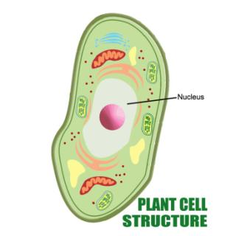
Nucleus
Controls functions of the cell
Contains DNA in chromosomes
Is surrounded by the nuclear membrane
Chromosome: structure of nucleic acids and proteins which carries genetic information in the form of genes

Slide 17
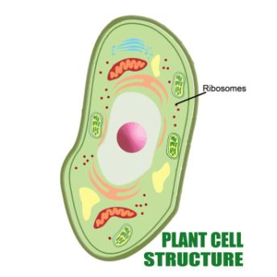
Ribosomes
Are small organelles found in large numbers in the cytoplasm
Create proteins from amino acids
Can only be seen
with an electron
microscope
Composed of two
subunits containing
RNA and proteins

Slide 18
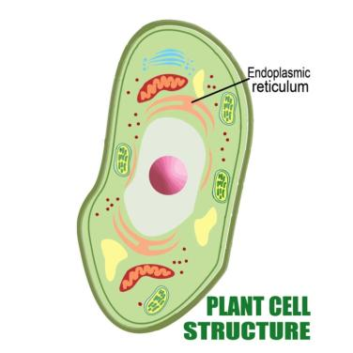
Rough Endoplasmic Reticulum
Is located in the cytoplasm
Is covered with ribosomes which give it a rough appearance
Transports materials through the cell, secretes,
stores and creates
proteins

Slide 19
Smooth Endoplasmic Reticulum
Is located in the cytoplasm
Transports materials through the cell
Contains enzymes
Produces and digests lipids and membrane proteins
Enzymes: proteins which assist chemical reactions in living cells

Slide 20
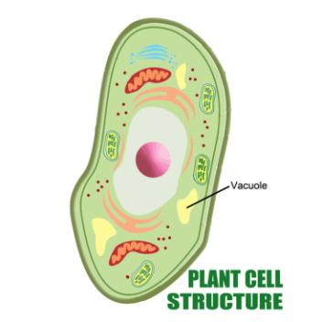
Vacuole
Is surrounded by a membrane
Is filled with fluid
Takes up most of the cell
Maintains the shape of the cell
Is the “cell trash can”

Slide 21
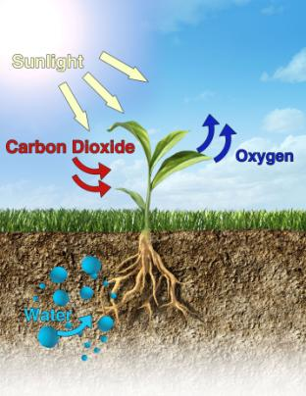
Photosynthesis
Is the process of converting light energy to chemical
energy
Takes place in the chloroplasts using chlorophyll

Slide 23
Assessment
1. Which of the following is NOT a characteristic of plants?
A. Creates food through photosynthesis
B. Are multicellular organisms
C. Are incapable of movement
D. Are capable of moving by themselves
2. What type of cells are found in bacteria?
A. Eukaryotic
B. Prokaryotic
C. Neither eukaryotic and prokaryotic
D. Both eukaryotic and prokaryotic

Slide 24
Assessment
3. Which plant part surrounds the cell as a thin layer of lipids and proteins?
A. Cell membrane
B. Golgi apparatus
C. Cell wall
D. Chloroplasts
4. Which plant part bonds with other plant cells to form the plants structure?
A. Cell membrane
B. Cell wall
C. Cytoplasm
D. Chloroplasts

Slide 25
Assessment
5. Which cell structure contains all organelles?
A. Cell membrane
B. Cell wall
C. Cytoplasm
D. Chloroplasts

Slide 28
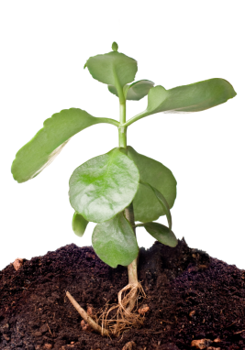
Roots
Are usually underground
Anchor plants in soil
Absorb water and nutrients
Can store food for plant

Slide 29
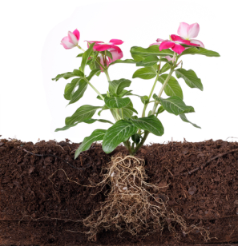
Root Tissues
Include:
epidermis
cortex
vascular cylinder or stele

Slide 30
Root Systems
Includes:
two major types:
taproot system
fibrous root system

Slide 31
Taproot System
Is found in many dicotyledons such as carrots and beats
Is derived directly from the first root emerging from the seed
Dicotyledons: flowering plants with two seed cotyledons

Slide 32
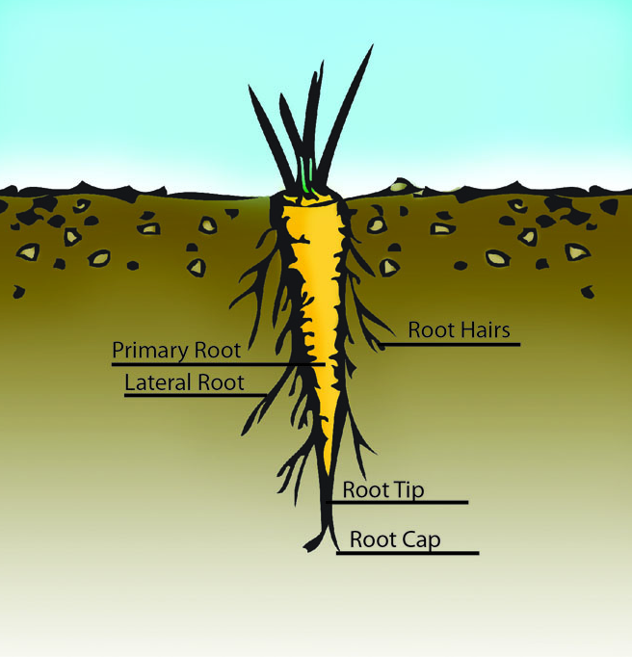
Taproot System
Has one prominent root known as the taproot or primary root

Slide 33
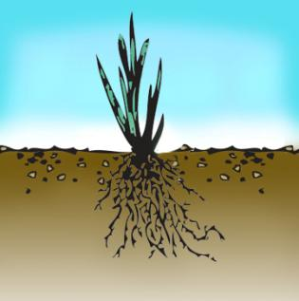
Fibrous Root System
Are found in most monocots
Consists of an extensive mass of smaller, widely spread roots
Monocots: flowering plants with only one seed cotyledon

Slide 34
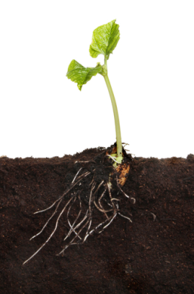
Root Types
Include:
taproots
lateral roots
adventitious roots
fibrous roots

Slide 35
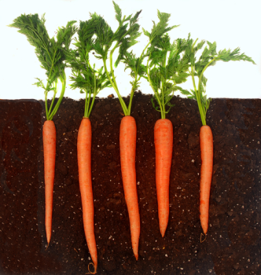
Taproot
Characteristics are:
Single, dominant roots
Grow directly downward
Sprout other fibrous roots
Can be modified for food and water storage and uptake

Slide 36
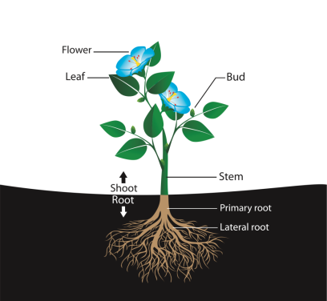
Lateral Roots
Extend horizontally from the taproot
Extract nutrients and water from the soil

Slide 37
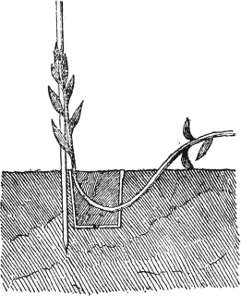
Adventitious Roots
Form from shoot tissues
Arise in stems and leaves
Are used when cloning plants from cuttings

Slide 38
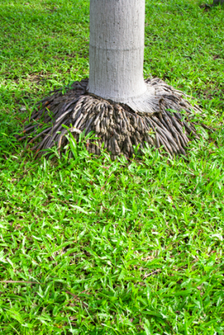
Fibrous Roots
Are thin, slender roots
Collect water and nutrients close to the soil surface
Sprout from primary roots

Slide 40
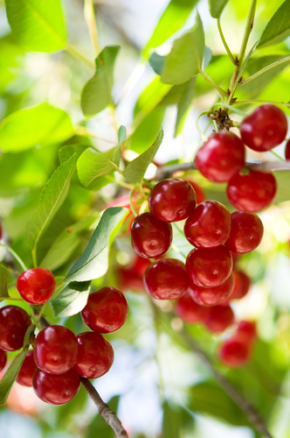
Stems
Support the leaves, flowers and fruits of plants
Conduct movement of
water and nutrients to
and from the roots
and leaves
Store water

Slide 41
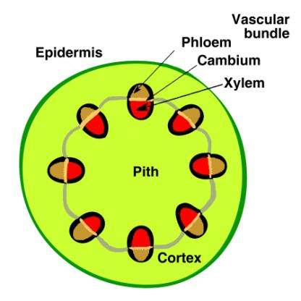
Stem Tissues
Include:
epidermis
cortex
xylem
phloem
cambium

Slide 42
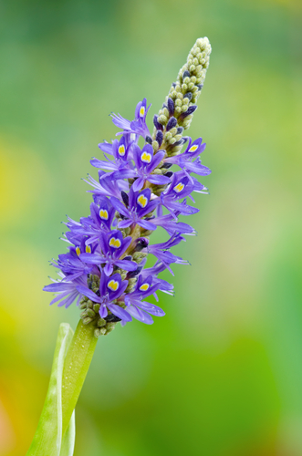
Stem Types
Include:
aerial
grow above ground
subterranean
grow below ground
acaulescent
no obvious stem above or below ground

Slide 43
Xylem
Transports water from the roots up the plant
Provides structure and support in the stem
Fun Fact: In trees, new xylem tissues are produced each year. As these new tissues are added, older xylem tissues die and create the “rings” that can be seen in tree trunks.

Slide 44
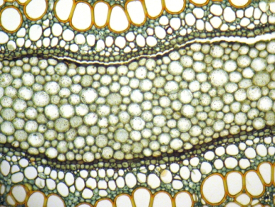
Phloem
Transports sugars and other molecules made during photosynthesis
Is always alive

Slide 46
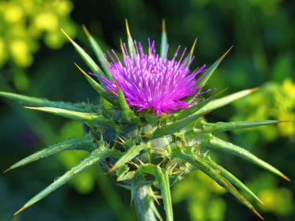
Flowers
Are organs for sexual reproduction
Produce gametes
Play a key role in pollination
Gamete: mature male or female sex cell which is able to unite with another of the opposite sex in sexual reproduction

Slide 47
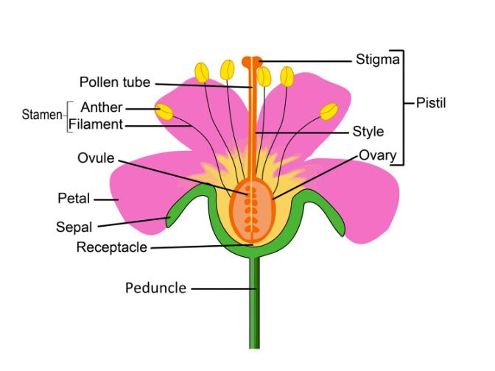
Flower Parts

Slide 48
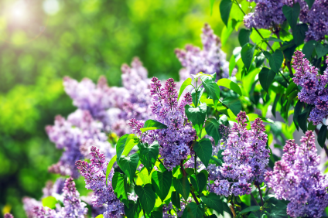
Flower Parts
Include:
peduncle
flower stalk
receptacle
part of flower stalk bearing floral organs
sepal
leaf structures at flower base, protects young buds, all together known as calyx

Slide 49
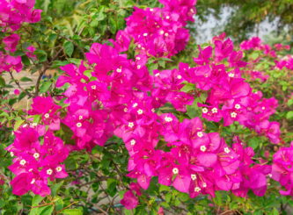
Flower Parts
Include:
petal
located in and above the sepals, attracts pollinators, all together known as corolla
stamen
male part of the flower, makes pollen grains
filament
stalk of the stamen, contains the anther

Slide 50
Flower Parts
Include:
anther
bears pollen
pollen
grains containing the male sex cells
pistil
female part of the flower

Slide 51
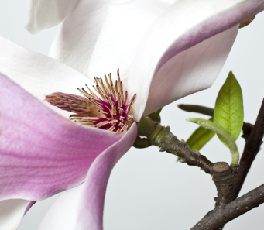
Flower Parts
Include:
stigma
sticky top of pistil, receptive surface for pollen grains
style
stalk of the pistil, where pollen tube grows

Slide 52
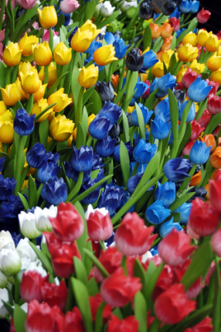
Flower Parts
Include:
ovary
base of the pistil, matures to become fruit
ovule
located in the ovary, carries female sex cells

Slide 53
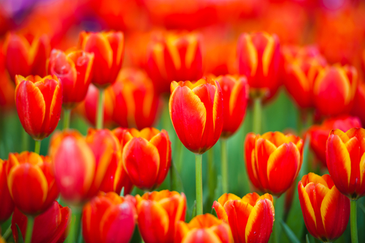
Flower Types
Include:
complete
has stamen, pistil, petals and sepals
incomplete
one part missing

Slide 54
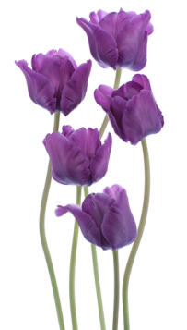
Flower Types
Include:
perfect
both stamen and pistil are present and functioning
imperfect
stamen or pistil is missing

Slide 56
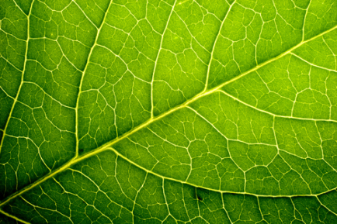
Leaves
Are the major site of food production for the plant (chloroplasts)
Contain structures which convert sunlight to chemical energy (photosynthesis)

Slide 57
Leaf Tissues
Include:
epidermis
mesophyll
veins

Slide 58
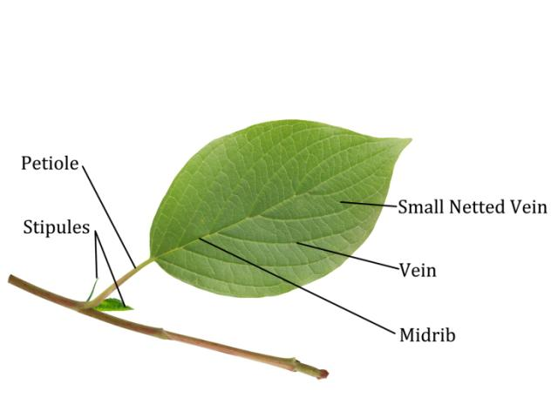
Leaf Parts

Slide 59
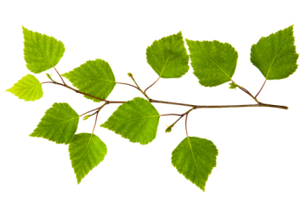
Leaf Parts
Include:
midrib
main, central vein of a leaf
petiole
leaf stalk which attaches the leaf to the plant
stem
main support of the plant

Slide 60
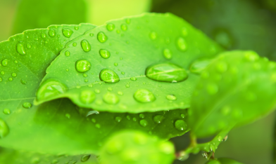
Leaf Parts
Include:
stipule
small, leaf-like appendages at the base of the petiole
vein
transports water, minerals and food energy throughout the plant

Slide 61
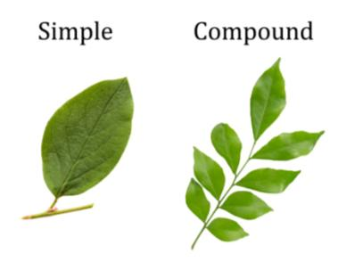
Leaf Types
Include:
simple
not divided into separate units
compound
leaflets arranged on both sides of an axis

Slide 62
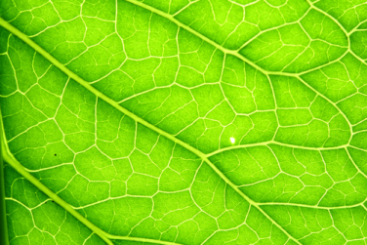
Leaf Vein Patterns
Include:
parallel
several large veins run alongside each other from the base of the blade to the tip (monocots)
palmate
several main veins of about equal size, all of which extend from a common point at the base of the leaf (dicots)

Slide 63
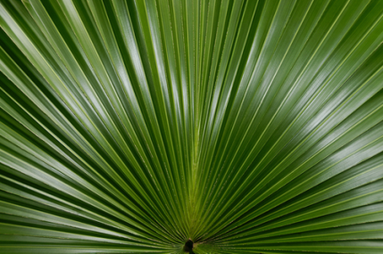
Leaf Vein Patterns
Include:
pinnate
one large, central vein, the midrib, with other large veins branching from the sides

Slide 64
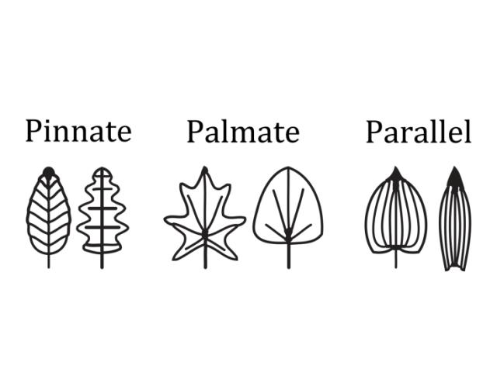
Leaf Vein Patterns

Slide 65
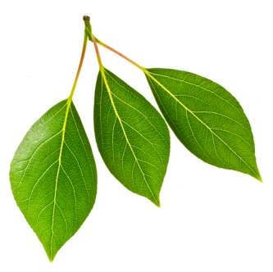
Leaf Arrangements
Include:
alternate
one leaf produced at each node
opposite
leaves in pairs at nodes
whorled
three or more leaves per node

Slide 66
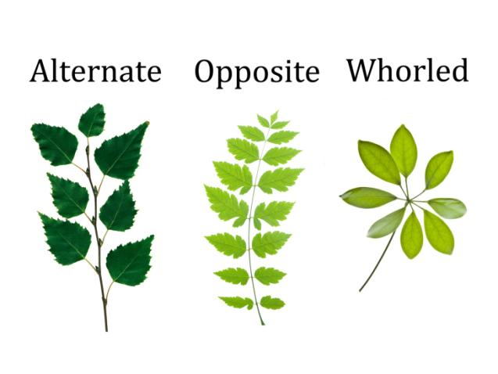
Leaf Arrangements

Slide 68
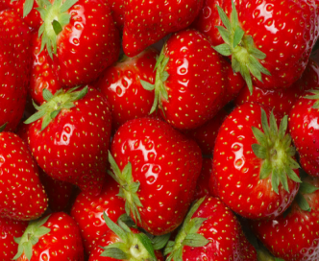
Fruit
Evolves from the maturing ovary after pollination and fertilization
May be either fleshy or dry in appearance
Plants produce fruit
to protect and
disseminate seeds
Contains one or
more seeds

Slide 69
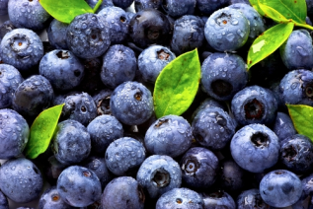
Fruit Types
Include:
simple
formed from one ovary
aggregate
formed from a single flower with many ovaries
multiple
developed from a fusion of separate flowers on a single structure

Slide 71
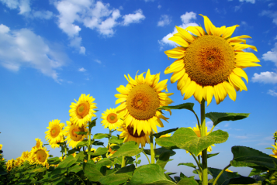
Seeds
Contain three parts:
seed coat
protects the embryo
cotyledon
temporary food supply, also known as seed leaf
embryo
young plant

Slide 72
Seeds

Slide 73
Monocots
Are embryos with a single cotyledon
Contain flower parts in multiples of three
Have adventitious roots
Store nutrients in endosperm

Slide 74
Dicots
Are embryos with two cotyledons
Contain flower parts in multiples of four or five
Have roots which form from the radical

Slide 76
Assessment
1. Which type of root system is found in grasses?
A. Taproot system
B. Fibrous root system
C. Adventitious roots system
D. Lateral system
2. Which type of roots grow directly downward?
A. Taproots
B. Lateral roots
C. Adventitious roots
D. Fibrous roots

Slide 77
Assessment
3. Which type of plant tissue is NOT part of the vascular bundle?
A. Phloem
B. Xylem
C. Cortex
D. Cambium
4. What types of stems are in plants?
A. aerial
B. subterranean
C. acaulescent
D. all of the above

Slide 78
Assessment
5. Which part of the stem transports sugars?
A. Phloem
B. Xylem
C. Cortex
D. Cambium
6. Which of the following is the female part of the plant?
A. Pistil
B. Stamen
C. Anther
D. Filament

Slide 79
Assessment
7. Which type of flower is missing either the pistil or the stamen?
A. Complete
B. Incomplete
C. Perfect
D. Imperfect
8. Which of the following is NOT a tissue found in the stem?
A. Xylem
B. Phloem
C. Cambium
D. Stele

Slide 80
Assessment
9. Which leaf part connects the leaf to the stem?
A. Mid-rib
B. Stipule
C. Vein
D. Petiole
10. Which of the following is NOT a fruit type?
A. Complex
B. Simple
C. Aggregate
D. Multiple

Slide 82
Final Assessment
1. Which cell structure has a double membrane surrounding it?
A. Golgi apparatus
B. Cytoplasm
C. Chloroplasts
D. Mitochondria
2. Which of the following is NOT a characteristic of the nucleus?
A. Controls functions of the cell
B. Contains DNA in chromosomes
C. Is surrounded by the nuclear membrane
D. Is spherical, rod-shaped organelles

Slide 83
Final Assessment
3. What are small organelles found in large numbers in the cytoplasm of a cell called?
A. Vacuole
B. Mitochondria
C. Ribosomes
D. Chloroplast
4. Where is rough endoplasmic reticulum located?
A. Cytoplasm
B. Ribosomes
C. Nucleus
D. Cell wall

Slide 84
Final Assessment
5. Which of the following is NOT a characteristics of a vacuole?
A. Filled with fluid
B. Does not contain a nuclei
C. Maintains the shape of the cell
D. Takes up most of the cell
6. How many primary roots are in a taproot system?
A. One
B. Three
C. Two
D. Four

Slide 85
Final Assessment
7. Which is NOT a function of the stem in plants?
A. Store water
B. Carry nutrients
C. Provide support to the plant
D. Anchor the plant in the ground
8. Which part of the flower is the peduncle?
A. Flower stem
B. Leaves
C. Roots
D. Reproductive parts

Slide 86
Final Assessment
9. In alternate leaf patterns, how many leaves are produced at each node?
A. Two
B. Three
C. Zero
D. One
10. The seed is made up of which of the following parts?
A. seed coat
B. cotyledon
C. embryo
D. all of the above

Slide 87
Resources
Plant Parts. The Great Plant Escape, Urban Programs Resource Network, University of Illinois Extension. Retrieved from http://urbanext.illinois.edu/gpe/case1/c 1facts2e.html
(2008). NY/NJ Trails + Rutgers Invasive Plant Monitoring Project. Rutgers School of Environmental and Biological Sciences. Rutgers, The State University of New Jersey. Retrieved from http://trails.rutgers.edu/identify.html
(2003) Plant Structure and Function. Andromeda Botanic Gardens. The University of the West Indies. Retrieved from http://andromeda.cavehill.uwi.edu/flower_structure _and_function.htm
Stern., Bidlack & Jansky, (2008). Introductory plant biology. (Eleventh Edition ed.). McGraw Hill.

Slide 88
Acknowledgements
Production Coordinators
Katelyn Perry
Graphic Designer
Melody Rowell
Technical Writer
Jessica Odom
V.P. of Brand Management
Clayton Franklin
Collaborators
Dick Auld, Ph.D.
Texas Tech University
Loren Casey Davis
Graduate Research Assistant
Texas Tech University
Executive Producer
Gordon W. Davis, Ph.D.
© MMXIV
CEV Multimedia, Ltd.

